Slide 1
AKSHAT DOCTOR
Mechanical Design Portfolio
(437) 234-5422
adoctor@uwaterloo.ca

Slide 2
MECHANICAL SECTION

Slide 3
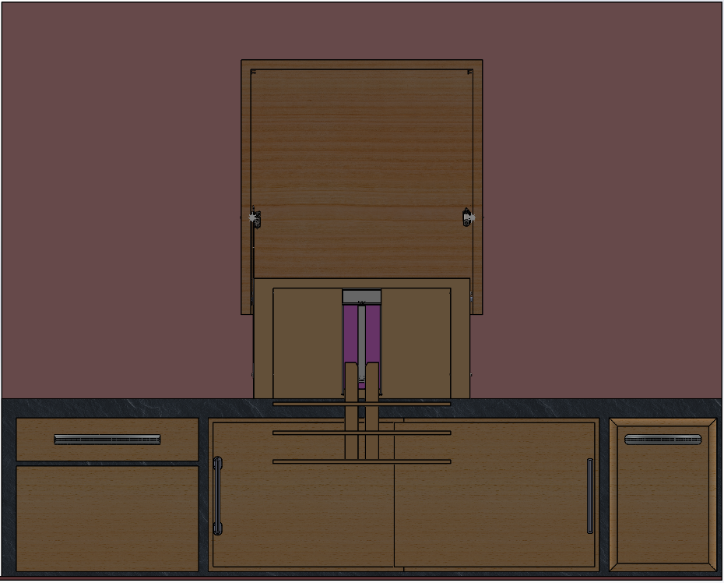
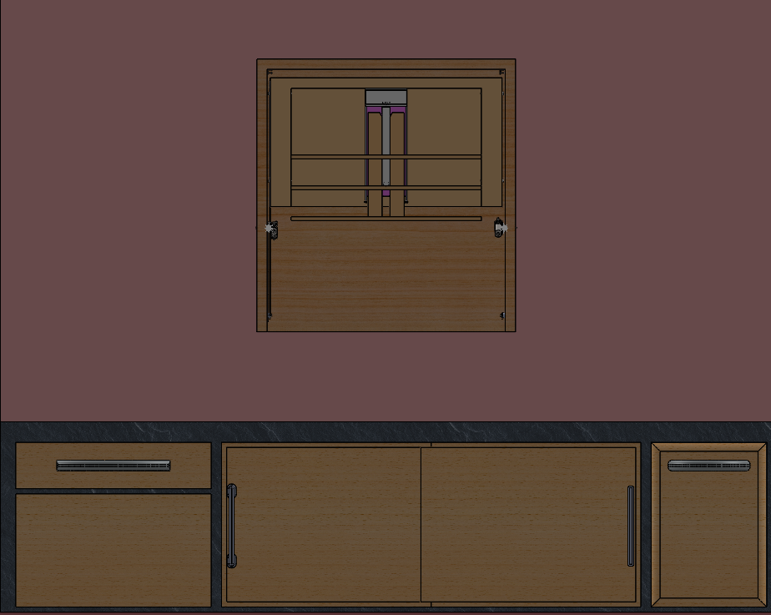
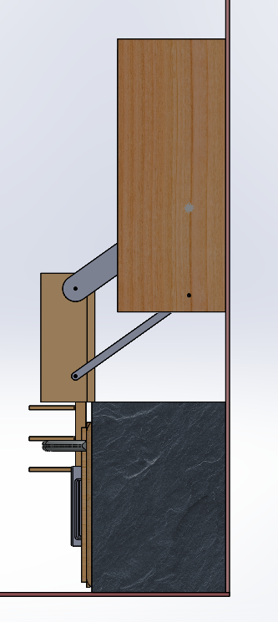
Accessibility Shelving Unit
Used SOLIDWORKS to design a shelving unit that can pivot down and extend for users who are unable to access high standing shelves
Design features a 4-bar rotating arms along with a belt driven linear descent system for the shelves

Slide 4
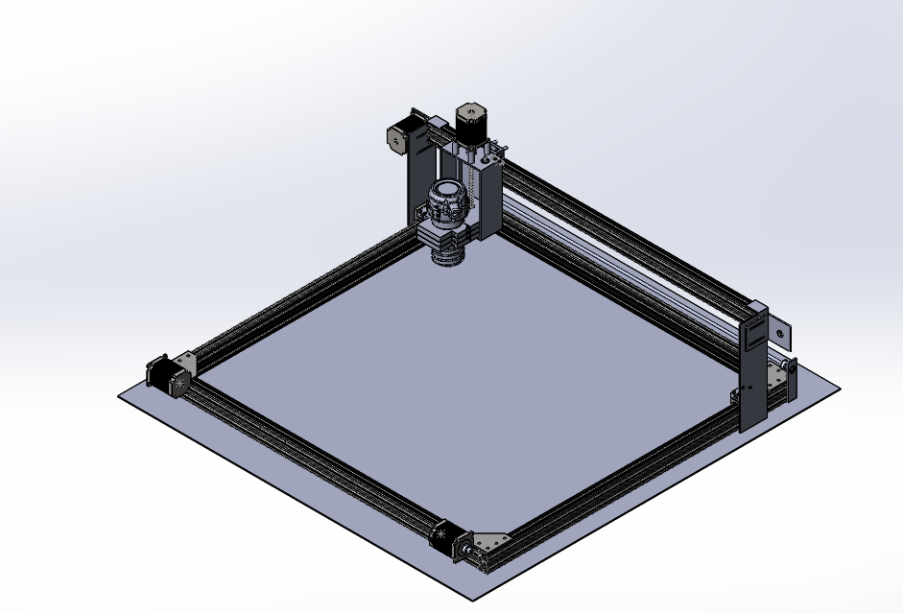
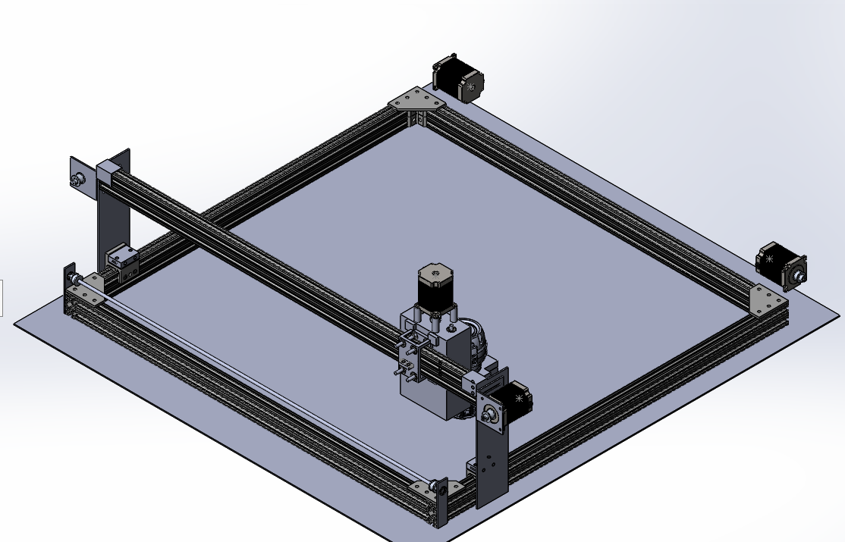
DIY CNC Project
Used SOLIDWORKS to model a 4ft by 4ft CNC Router/Laser Engraving machine using custom plywood parts along with Commercially Off the Shelf(COTS) products
The X-Axis and Y-Axis are driven using belts and a NEMA 23 stepper motor
The Z-Axis is driven by a NEMA 23 and a lead screw attached to a DeWalt Router holder

Slide 5
Next Steps
Add electronics and wire routing system for different axis
Review design with engineers/technicians

Slide 6
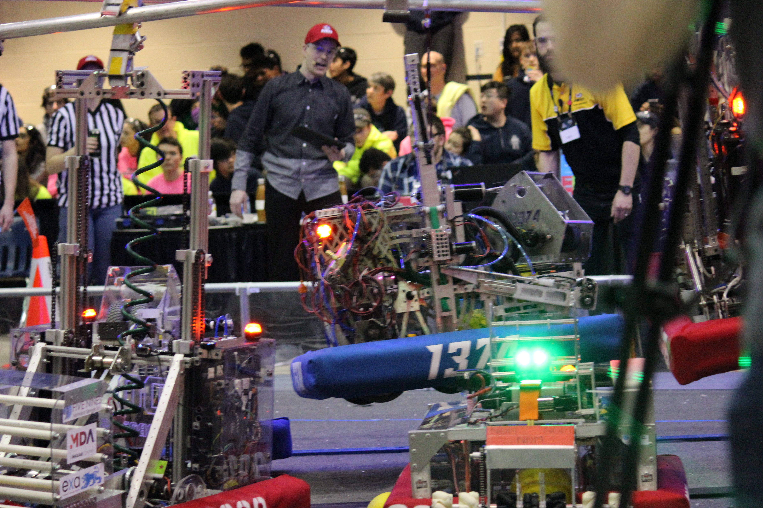
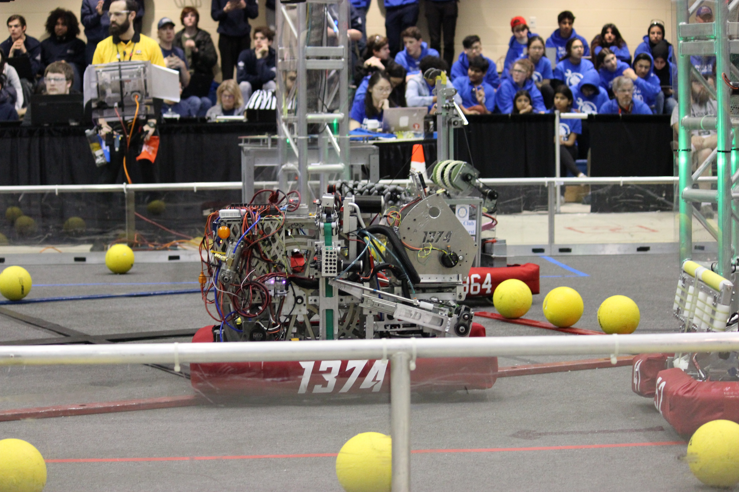
FRC Team 1374 Robot: Climber System
Designed a climbing system for a robotics competition using SOLIDWORKS
Constructed & Maintained the climber throughout the 8 week competition period

Slide 7
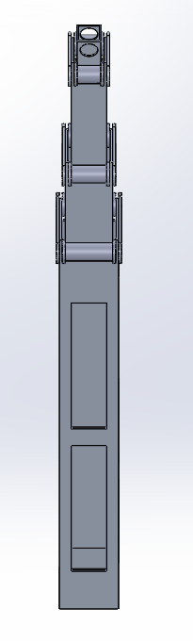
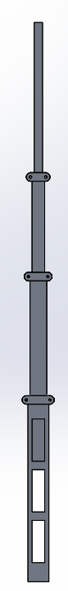
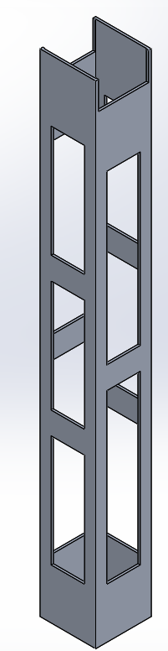
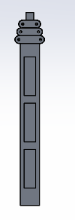
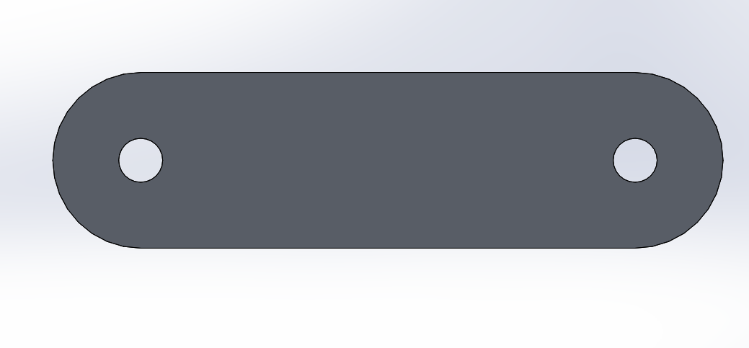
Design of Climber: Tubing
Extended
The main focus was to create a compact system that would allow the robot to be small and nimble
Used four sets of Square 6061 Aluminum Tubing (2.5x2.5in, 2x2in, 1.5x1.5in and 1x1in) to create a telescopic arm
Delrin rollers used on the outside to carry belt rigging and align tubes as structure rose
Used HSMWorks to generate toolpaths and G-Code for slots on tubes
Used Plasma Cutter to create slot profile
Roller View
Compressed

Slide 8

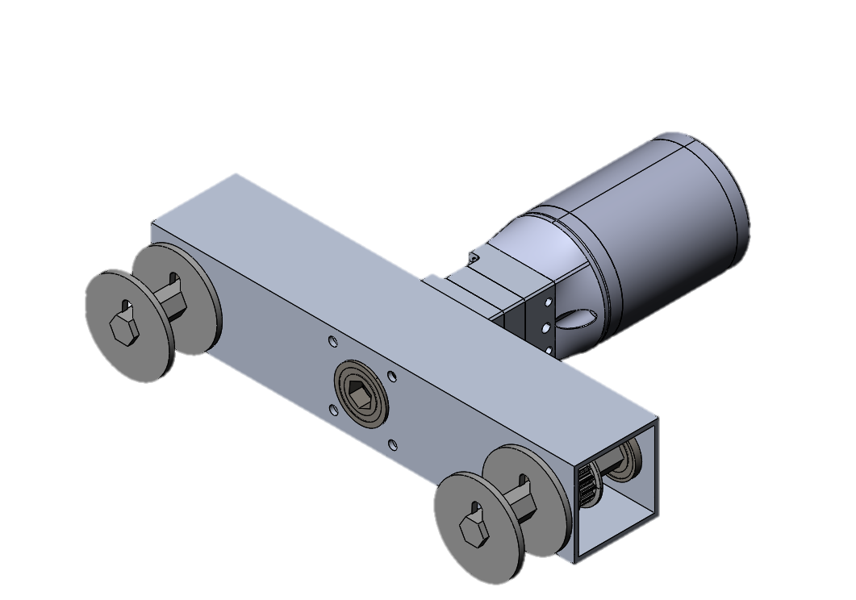
Design of Climber: Winch System
The winch system utilizes a 100:1 brushed DC motor
The gearbox is attached to an axle that contains the winch caps
A pin is placed between caps to hold the belt in place between itself and the axle
Using a ½” Socket, the winch is can be tightened easily
Winch Caps
Winch System

Slide 9
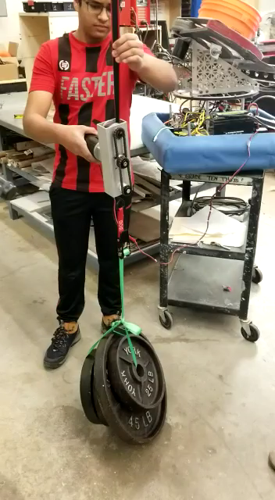
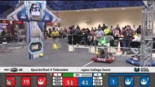
These are videos of the climber working. For the YouTube video, start at 2:08 and watch the robot with a blue bumper and the number “1374”

Slide 10
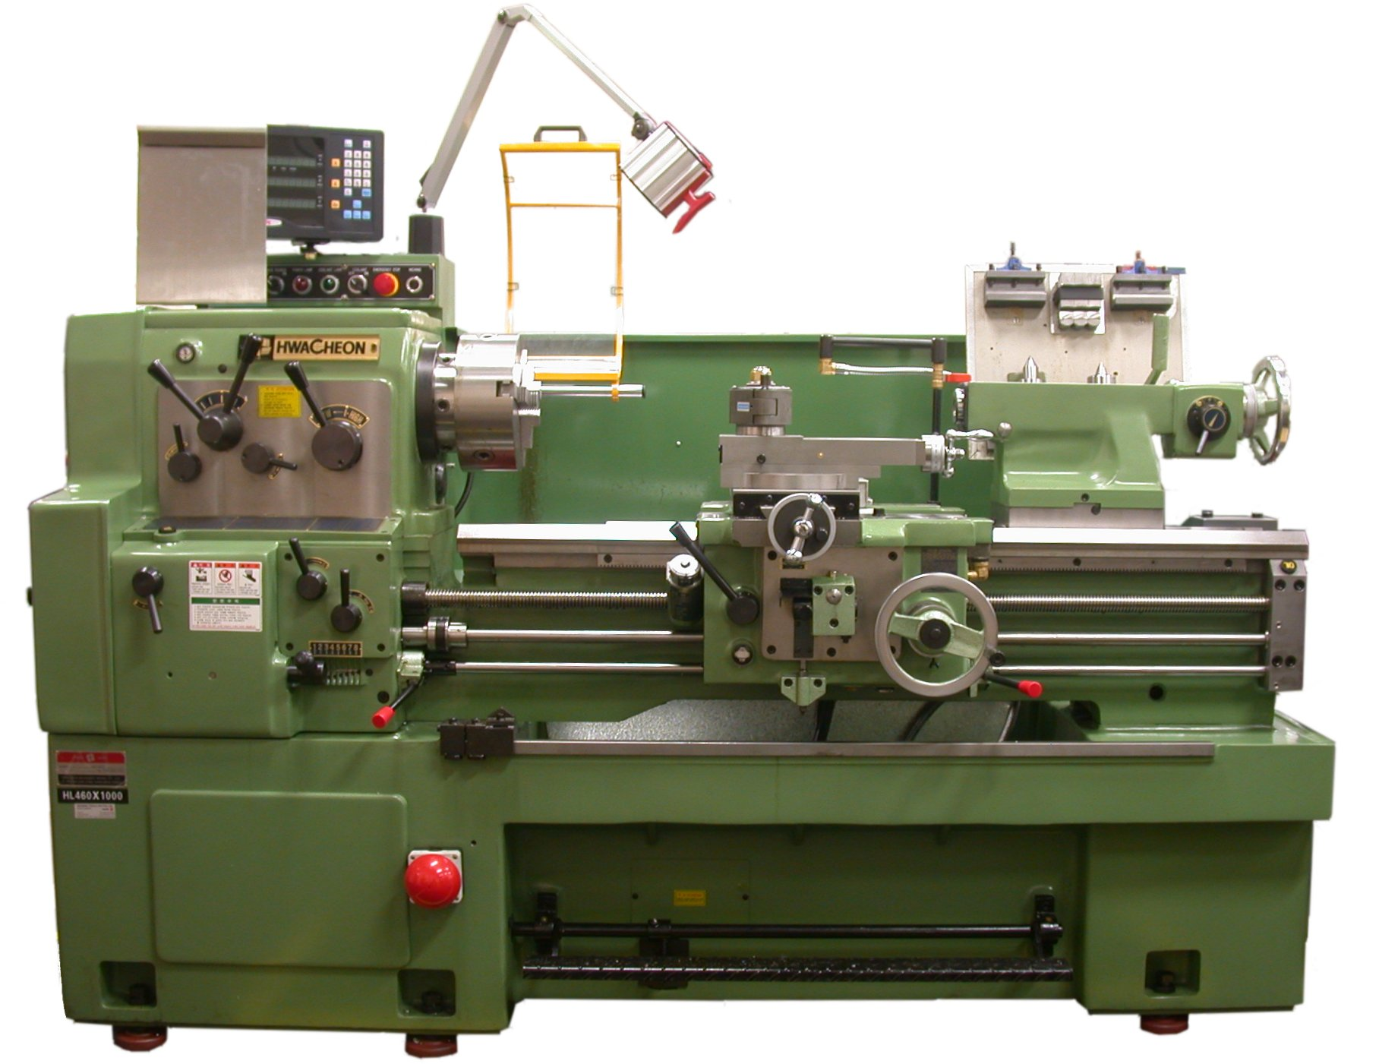
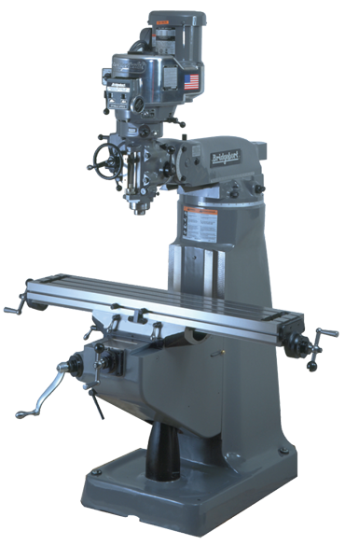
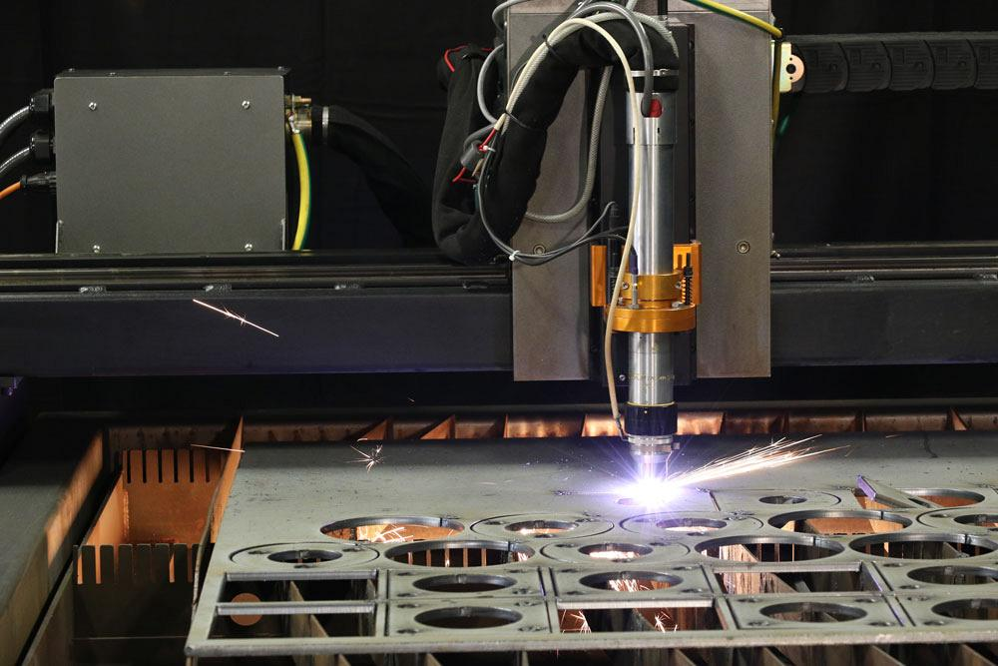
Construction
This climber system was built using a CNC Machine, Vertical Mill, Lathe, Bandsaw, Drill Press, Plasma Cutter, Horizontal Cut-off saw along with many hand tools

